Slide 1
Chemistry in Dailylife
Dr. P. K. Sreekumar
Associate Professor, Dept. of Chemistry
NSS College, Pandalam

Slide 2
Food
Detergents
Fabrics
Explosives
Chemistry
Pesticide
Rocket Fuel
Energy
Medicine
Safety

Slide 3
Chemistry in Food Materials

Slide 4
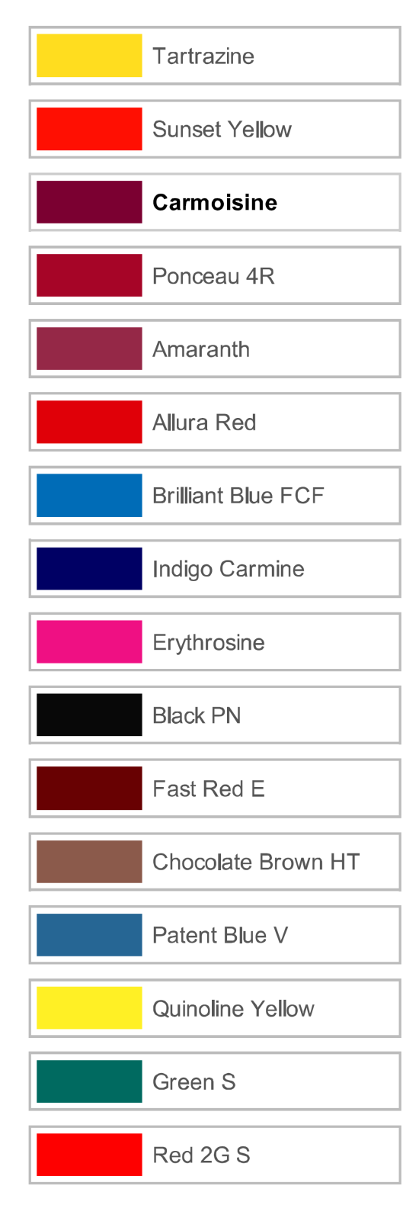
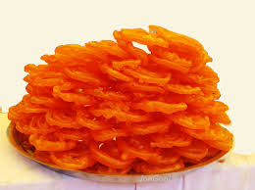
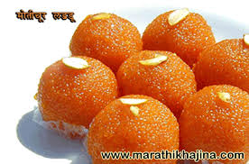
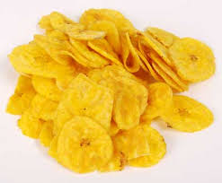
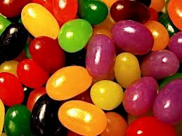
Colour in Food material

Slide 5
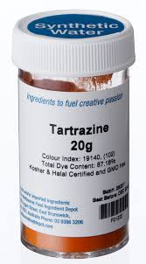
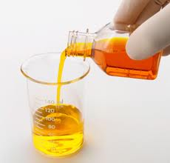
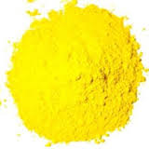
Tartrazine
A synthetic lemon yellow azo dye primarily used as a food coloring.

Slide 6
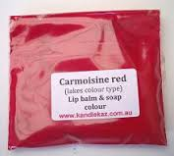
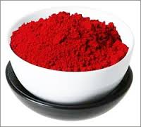
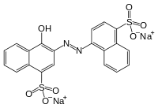
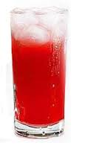
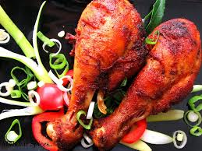
Carmoisine

Slide 7
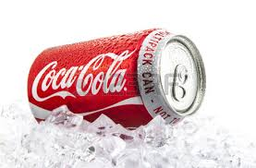
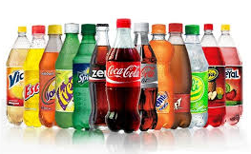
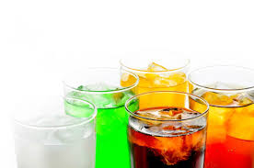
Carbonated Beverages
Content
Carbonated water
Sugar
Caffeine
Phosphoric acid
Caramel color
Natural flavorings
carbonated beverage, an effervescent drink that releases carbon dioxide under conditions of normal atmospheric pressure

Slide 8
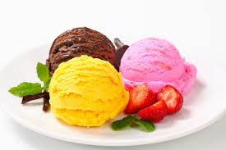
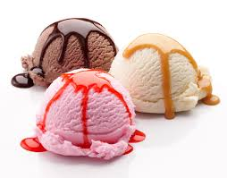
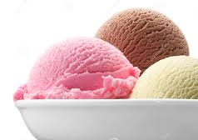
Ice Cream
The main ingredients in ice cream are
Milk
Sugar
Milk or vegetable fat
flavour

Slide 9
Chemistry in Medicine

Slide 10
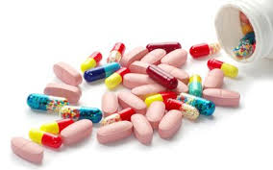
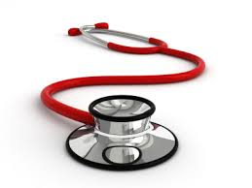
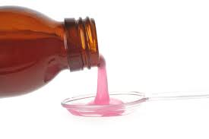
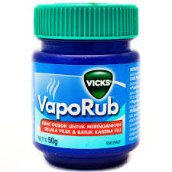
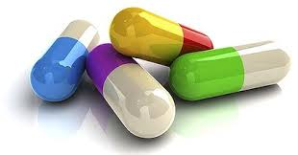
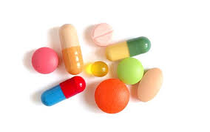
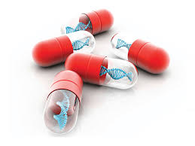
Medicine

Slide 11
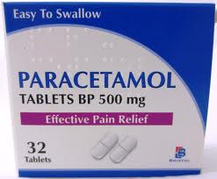
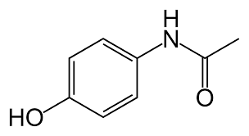
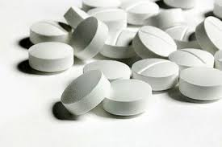
Paraceteamol
Analgesics, antipyretics
& anti inflammatory drugs

Slide 12
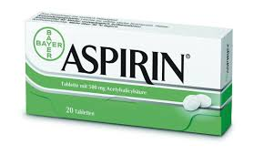
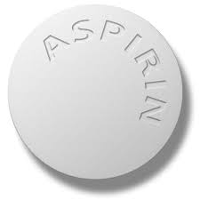
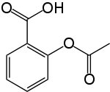
Aspirin, also known as acetylsalicylic acid is a salicylate drug, often used as an analgesic to relieve minor aches and pains, as an antipyretic to reduce fever, and as an anti-inflammatory medication

Slide 13
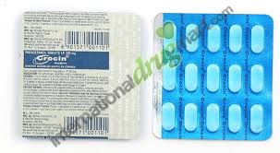
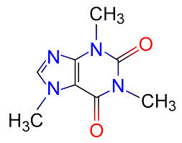
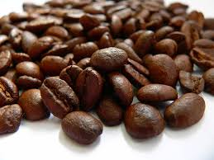
Crocin
Each uncoated tablet contains Paracetamol IP 650 mg, Caffeine Anhydrous IP 50 mg
Caffeine is a bitter, white crystalline xanthine alkaloid found in the seeds, nuts, or leaves of a small number of South American plants. The most well known source of caffeine is the seed of the coffea arabica coffee plant

Slide 14
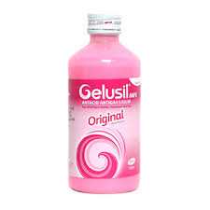
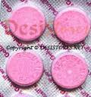
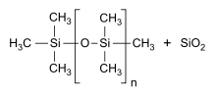
Antacid
Gelusil is drug that treats heartburn, acid indigestion and gas.
Its main ingredients are
Aluminum hydroxide ,
Magnesium hydroxide
Simethicone.
Al(OH)₃ Mg(OH)₂
Simethicone is an orally administered anti-foaming agent used to reduce bloating, discomfort or pain caused by excessive gas

Slide 15
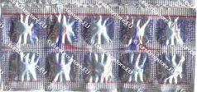
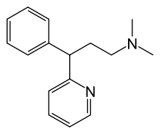
Avil
Pheniramine is a drug used to treat allergic conditions such as hay fever. Pheniramine is also commonly found in eyedrops used for the treatment of allergic conjunctivitis.

Slide 16
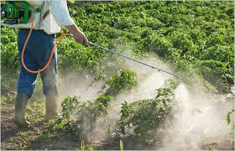
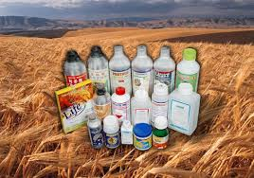
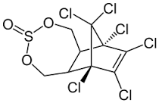
Pesticide

Slide 17
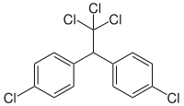
DDT
DDT ("dichlorodiphenyltrichloroethane") is a colorless, crystalline, tasteless and almost odorless organochloride known for its insecticidal properties
First synthesized in 1874, DDT's insecticidal action was discovered by the Swiss chemist Paul Hermann Müller in 1939. It was then used in the second half of World War II to control malaria and typhus among civilians and troops. After the war, DDT was made available for use as an agricultural insecticide and its production and use duly increased. Müller was awarded the Nobel Prize in Physiology or Medicine "for his discovery of the high efficiency of DDT as a contact poison against several arthropods" in 1948

Slide 18
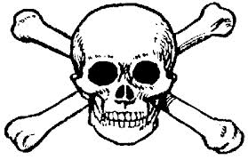

Slide 19
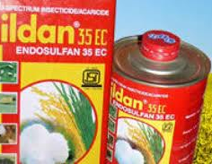
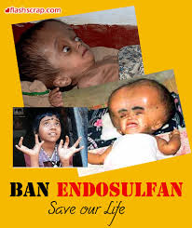
Endosulfan is an organochlorine insecticide and acaricide

Slide 20
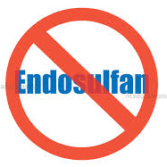

Slide 21
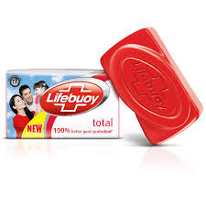
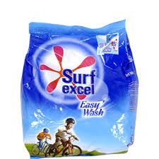
Soap, Detergents and Shampoo

Slide 22
Soap
In chemistry, soap is a salt of a fatty acid.
Soaps are obtained by treating vegetable or animal oils and fats with a strongly alkaline solution.
Fats and oils are composed of triglycerides; three molecules of fatty acids are attached to a single molecule of glycerol.
The alkaline solution brings about a chemical reaction known as saponification.

Slide 23
Tooth Paste
Active Ingredient:
sodium monofluorophosphate (1.1%)
Other Ingredients:
Calcium Carbonate,
Water,
Sorbital,
Hydrated Silca,
Sodium Lauryl Sulphate,
Sodium Monoflurophosphate,
Flavor,
Cellulose Gum,
Magnesium Aluminum Silicate,
Sodium Carbonate,
Sodium Saccharin, Sodium Bicarbonate, Methylparaben,
Propylparaben

Slide 24
Explosives

Slide 26
Safety

Slide 27
Fire Extinguisher
Water Extinguishers
Water extinguishers are filled with regular tap water and typically pressurized with air. The most common way to remove heat is to spray water on the fire; however, depending on the type of fire, this approach is not always the best option.
Dry Chemical Extinguishers
Dry chemical extinguishers are filled with foam or powder, usually potassium bicarbonate or sodium bicarbonate (baking soda), and pressurized with nitrogen. Baking soda is effective because it decomposes at 158 degrees Fahrenheit and releases carbon dioxide,

Slide 28
Airbag in Car

Slide 29
LPG
Liquefied petroleum gas or liquid petroleum gas (LPG or LP gas), also referred to as simply propane or butane, are flammable mixtures of hydrocarbon gases used as fuel in heating appliances, cooking equipment, and vehicles
Ethyl merceptane or ethane-thiol

Slide 30
Rocket Fuel
Liquid propellants
The most common liquid propellants in use today:
Liquid Oxygen and kerosene . Used for the first stages of the Saturn V, Atlas V and Falcon, the Russian Soyuz.
Liquid Oxygen and liquid hydrogen, used in the Space Shuttle orbiter, the Centaur upper stage of the Atlas V, Saturn V upper stages, the newer Delta IV rocket, the H-IIA rocket, and most stages of the European Ariane 5 rocket.
Nitrogen tetroxide (N₂O₄) and hydrazine (N₂H₄). Used in military, orbital, and deep space rockets because both liquids are storable for long periods at reasonable temperatures and pressures. The main fuel for the Proton rocket, Long March rockets, PSLV, and Fregat and Briz-M upper stages. The major inconvenience is that these propellants are highly toxic, hence they require careful handling.
Hydrogen peroxide, hydrazine, and nitrous oxide are primarily used for attitude control and spacecraft station-keeping where their long-term storability, simplicity of use, and ability to provide the tiny impulses needed, outweighs their lower specific impulse as compared to bipropellants. Hydrogen peroxide is also used to drive the turbopumps on the first stage of the Soyuz launch vehicle.

Slide 31
Principal components include
n-heptane and isooctane.

Slide 32
Thank you

